Slide 1

Data Types

Slide 2
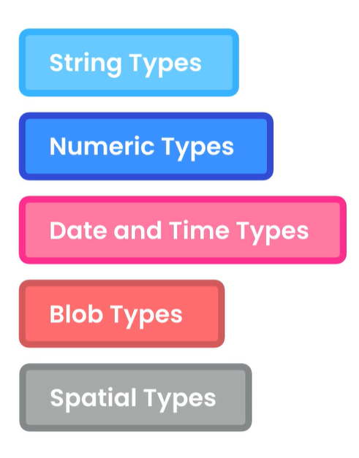
MySql DATA Types
Blob types: for storing binary data.
Spatial types: Geographical values

Slide 3

STRINGS
VARCHAR(x) for username first name
CHAR(x) fixed-length

Slide 4
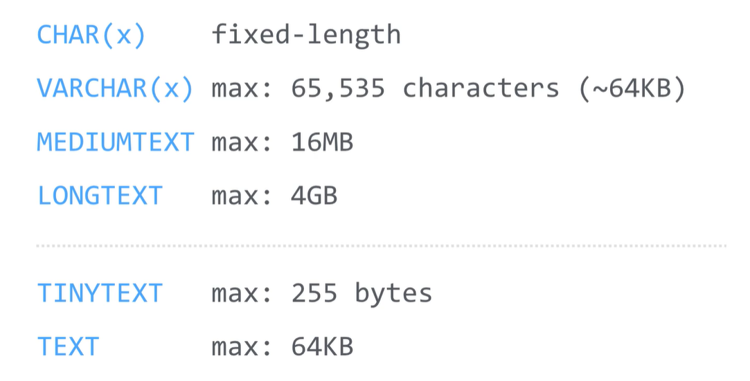
STRINGS
MEDIUMTEXT its good for storing json objects
LONGTEXT its good for storing years of logs files

Slide 5
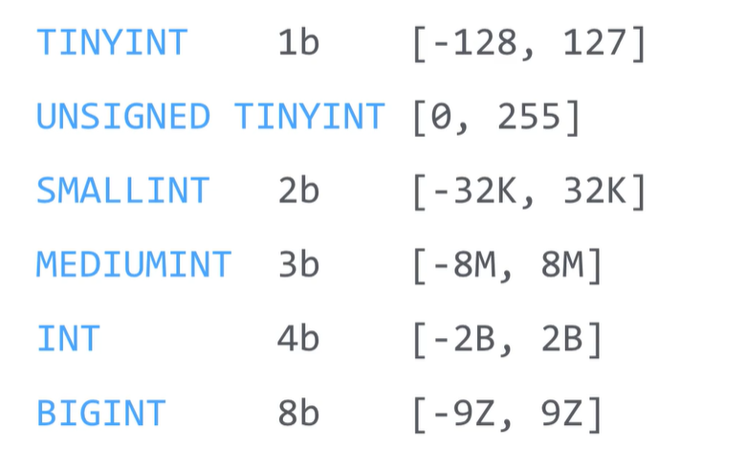
Integer Types
Store numbers without decimal point such like 1,2,3,4
The number that we can store depends on the bytes size that assign to the type

Slide 6
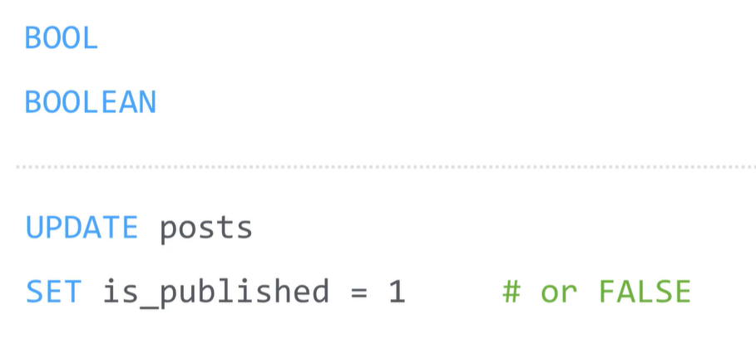
Boolean types
U can use both true/false or 1/0

Slide 7
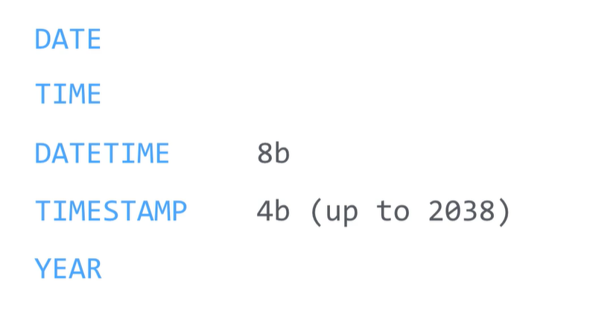
DATE/Time
Date to store date without time

Slide 8
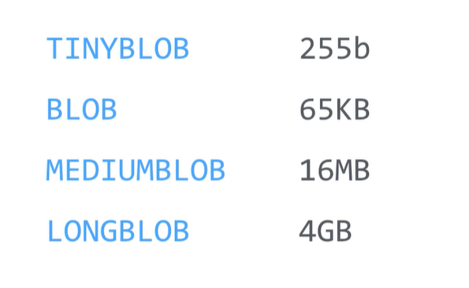
Blobs types
To store binary data

Slide 9
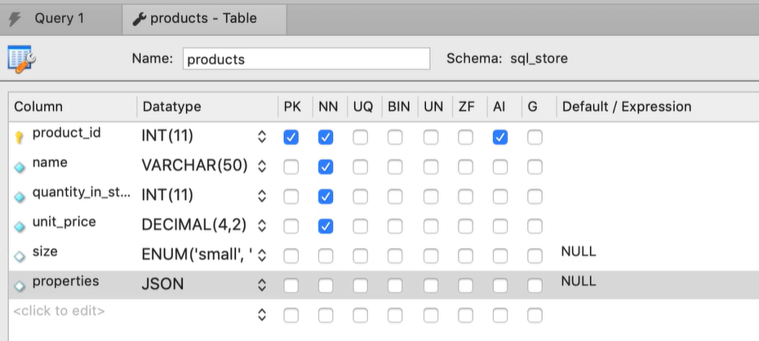
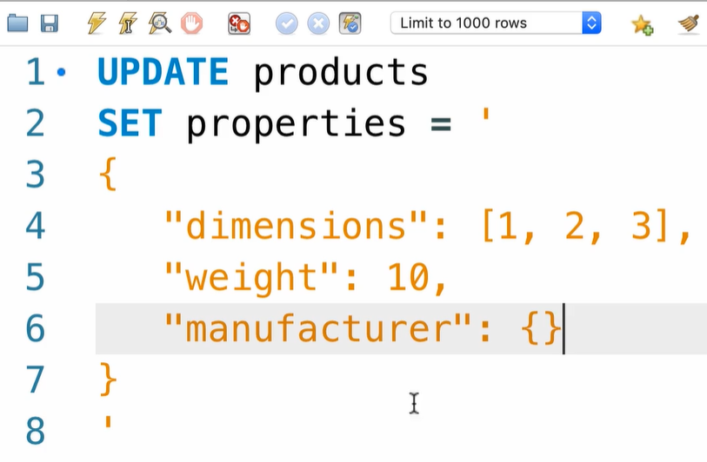
JSON type
Lightweight format for storing and transfer data over the internet

Slide 10
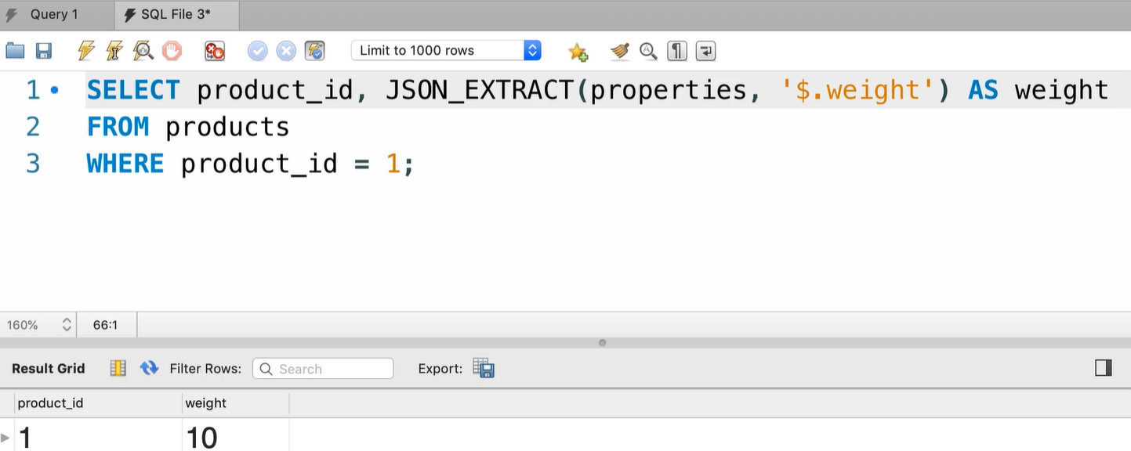
JSON types

